Slide 1

Apex Institute of Technology
Department of Computer Science & Engineering
Data Mining and Warehousing
(CSF-334)
Dr Neha Agarwal
E11231
Assistant Professor
CSE(AIT), CU
DISCOVER . LEARN . EMPOWER

Slide 2
Contents to be Covered
Mining multidimensional association rules from transactional databases and data warehouse

Slide 3
Multi-Dimensional Association: Concepts
Single-dimensional rules:
buys(X, “milk”) ⇒ buys(X, “bread”)
Multi-dimensional rules:  2 dimensions or predicates
Inter-dimension association rules (no repeated predicates)
age(X,”19-25”) ∧ occupation(X,“student”) ⇒ buys(X,“coke”)
hybrid-dimension association rules (repeated predicates)
age(X,”19-25”) ∧ buys(X, “popcorn”) ⇒ buys(X, “coke”)
Categorical Attributes
finite number of possible values, no ordering among values
Quantitative Attributes
numeric, implicit ordering among values

Slide 4
Techniques for Mining MD Associations
Search for frequent k-predicate set:
Example: {age, occupation, buys} is a 3-predicate set.
Techniques can be categorized by how age is treated:
1. Using static discretization of quantitative attributes
Quantitative attributes are statically discretized by using predefined concept hierarchies.
2. Quantitative association rules
Quantitative attributes are dynamically discretized into “bins”based on the distribution of the data.
3. Distance-based association rules
This is a dynamic discretization process that considers the distance between data points.

Slide 5
Static Discretization of Quantitative Attributes
Discretized prior to mining using concept hierarchy.
Numeric values are replaced by ranges.
In relational database, finding all frequent k-predicate sets will require k or k+1 table scans.
Data cube is well suited for mining.
The cells of an n-dimensional
cuboid correspond to the
predicate sets.
Mining from data cubes can be much faster.
()
(age)
(income)
(buys)
(age, income)
(age,buys)
(income,buys)
(age,income,buys)

Slide 6
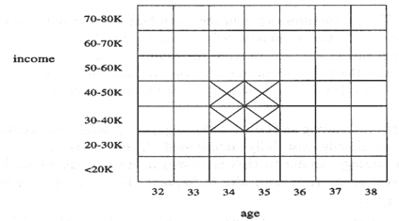
Quantitative Association Rules
Numeric attributes are dynamically discretized
Such that the confidence or compactness of the rules mined is maximized.
2-D quantitative association rules: A_{quan1} ∧ A_{quan2} ⇒ A_{cat}
Cluster “adjacent”
association rules
to form general
rules using a 2-D
grid.
Example:
age(X,”30-34”) ∧ income(X,”24K - 48K”)
⇒ buys(X,”high resolution TV”)

Slide 7
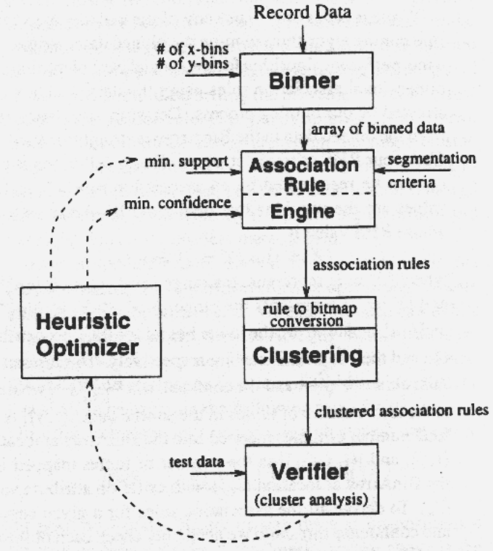
ARCS (Association Rule Clustering System)
How does ARCS work?
1. Binning
2. Find frequent predicate set
3. Clustering
4. Optimize

Slide 8
Limitations of ARCS
Only quantitative attributes on LHS of rules.
Only 2 attributes on LHS. (2D limitation)
An alternative to ARCS
Non-grid-based
equi-depth binning
clustering based on a measure of partial completeness (information lost due to partitioning).
“Mining Quantitative Association Rules in Large Relational Tables” by R. Srikant and R. Agrawal.

Slide 9
Mining Distance-based Association Rules
Binning methods do not capture the semantics of interval data
Distance-based partitioning, more meaningful discretization considering:
density/number of points in an interval
“closeness” of points in an interval

Slide 10
Clusters and Distance Measurements
S[X] is a set of N tuples t₁, t₂, …, t_{N} , projected on the attribute set X
The diameter of S[X]:
dist_{x}:distance metric, e.g. Euclidean distance or Manhattan

Slide 11
Clusters and Distance Measurements
The diameter, d, assesses the density of a cluster C_{X} , where
Finding clusters and distance-based rules
the density threshold, d₀ , replaces the notion of support
modified version of the BIRCH clustering algorithm
Distance between clusters measures degree of association

Slide 12
Homework
Discuss the Techniques for Mining MD Associations.
Discuss limitations of ARCS?

Slide 13
References
TEXT BOOKS
Introduction to Data Mining, Tan, Steinbach and Vipin Kumar, Pearson Education, 2016
REFERENCE BOOKS
Data Mining: Concepts and Techniques, Pei, Han and Kamber, Elsevier (2nd edition)
Journals
https://www.sciencedirect.com/science/article/pii/B9780323857086000084

Slide 14
Thank you
Please Send Your Queries on:
e-Mail: neha.e11231@cumail.in

